Slide 1
Java for FTC 101
Session 1: Introduction to FTC Programming

Slide 2
Overview
Hardware Overview
Coding/Java Fundamentals
Making Decisions (Logic and their Gates)
First OpMode
Depending on speed maybe start Session 2??

Slide 3
Hardware Overview

Slide 4
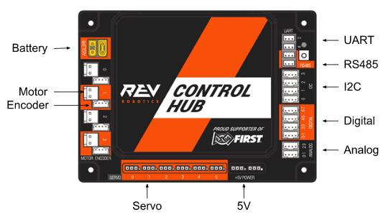
Robot Controller (RC): Understanding the REV Control Hub
Hardware Overview

Slide 5
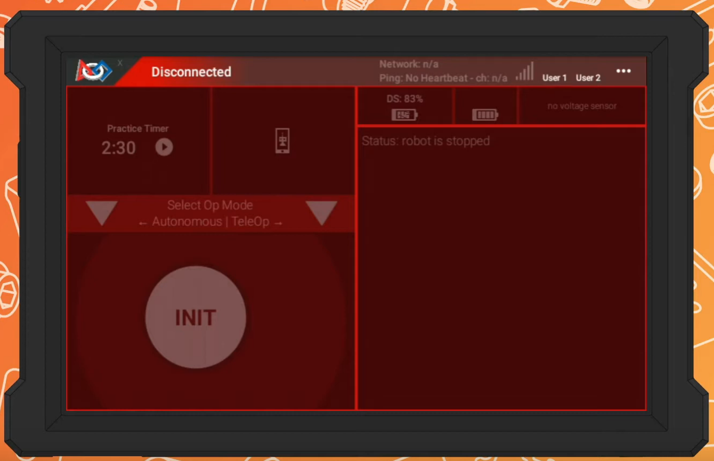
Driver Station: Interface and functionality
Connecting to WIFI:
Hardware Overview

Slide 6
Driver Station: Interface and functionality
Connecting to WIFI:
Go to the hubs WIFI
(Scroll down then hold the WIFI option)
Hardware Overview

Slide 7
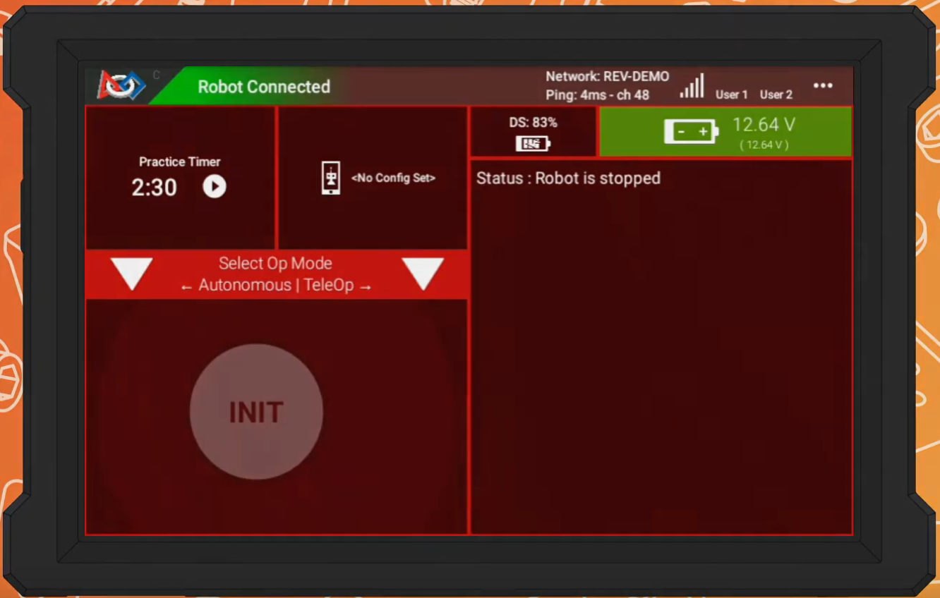
Driver Station: Interface and functionality
Connecting to WIFI:
Go to the hubs WIFI
(Scroll down then hold the WIFI option)
Hardware Overview

Slide 8
Driver Station: Interface and functionality
*Additional Stuff
Driver Station Battery
Battery Voltage
Auto menu
Telemetry Data Menu
(Must be programmed)
TeleOp menu
Hardware Overview

Slide 9
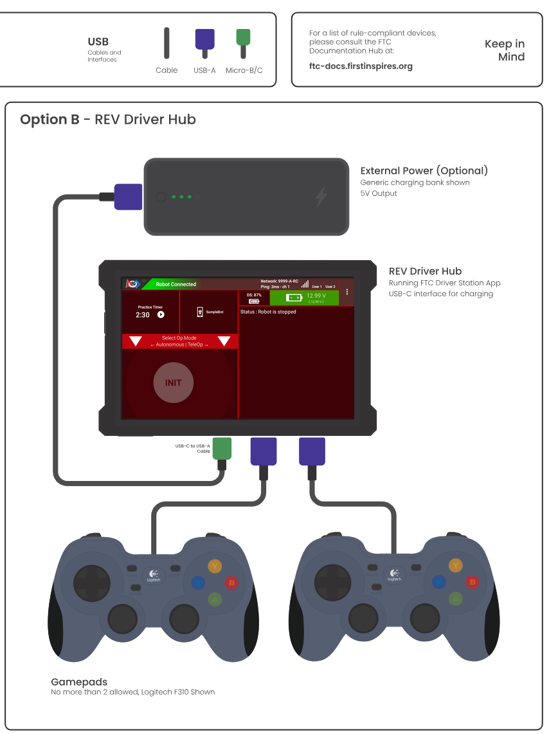
Driver Station: Interface and functionality
Hardware Overview

Slide 10
Driver Station: Interface and functionality
Starting the robot (Safely)
Init, Enable, Disable
Countdown to Auto (and videos :O )
Hardware Overview

Slide 11
Coding/Java Fundamentals

Slide 12
Primitive data types
Category: Integer… * Denotes Important
Type | Size (Bits) | Precision
byte | 8 | From +127 to -128
char | 16 | All Unicode characters
short | 16 | From +32,767 to -32,768
int * | 32 | From +2,147,483,647 to -2,147,483,648
long | 64 :O | From +9,223,372,036,854,775,807 to -9,223,372,036,854,775,808
Coding/Java Fundamentals

Slide 13
Primitive data types
Category: Floating Point… * Denotes Important
Type | Size (Bits) | Precision
float | 32 | From 3.402,823,5 E+38 to 1.4 E-45
double * | 64 | From 1.797,693,134,862,315,7 E+308 to 4.9 E-324
Coding/Java Fundamentals

Slide 14
Primitive data types
Category: Other… * Denotes Important
Type | Size (Bits) | Precision
boolean * | -- | false, true
void * | -- | --
Coding/Java Fundamentals

Slide 15
Primitive data types
Category: Important
Type | Notes – Use them in this order
boolean | Can only be true or false. Used for flags and logic statements
int | Used for whole numbers (I.E. Ticks, bool math, indexing etc.)
double | Used for decimals, helpful but easy to overuse leading to problems.
void | Used when nothing is returned or stored, this is the same as having a “return returnAddress” which is what java will auto compiles this as.
Coding/Java Fundamentals

Slide 16
Primitive data types
ints VS doubles
Math Operations (+, -, *, /)
int integerValue = 10; double doubleValue = 3.14; int resultInt = 7 / 3; double resultDouble = 7.0 / 3.0;
Coding/Java Fundamentals

Slide 17
Primitive data types
ints VS doubles
Math Operations (+, -, *, /)
int integerValue = 10; double doubleValue = 3.14; // Integer division truncates the decimal part int resultInt = 7 / 3; // result Int will be 2 // Double division preserves the decimal part double resultDouble = 7.0 / 3.0; // result Double will be approximately 2.3333
Coding/Java Fundamentals

Slide 18
Primitive data types
The char: ints are chars but with more steps
33: ! 34: " 35: # 36: $ 37: % 38: & 39: ' 40: ( 41: ) 42: * 43: + 44: , 45: - 46: . 47: / | 48: 0 49: 1 50: 2 51: 3 52: 4 53: 5 54: 6 55: 7 56: 8 57: 9 58: : 59: ; 60: < 61: = 62: > | 63: ? 64: @ 65: A 66: B 67: C 68: D 69: E 70: F 71: G 72: H 73: I 74: J 75: K 76: L 77: M | 78: N 79: O 80: P 81: Q 82: R 83: S 84: T 85: U 86: V 87: W 88: X 89: Y 90: Z 91: [ 92: \ | 93: ] 94: ^ 95: _ 96: ` 97: a 98: b 99: c 100: d 101: e 102: f 103: g 104: h 105: i 106: j 107: k | 108: l 109: m 110: n 111: o 112: p 113: q 114: r 115: s 116: t 117: u 118: v 119: w 120: x 121: y 122: z | 123: { 124: | 125: } 126: ~
Coding/Java Fundamentals

Slide 19
(Other) Variables and Data Types
Category: Other… * Denotes Important
Type | Notes
String * | Represents a sequence of characters. Strings are immutable, meaning their values cannot be changed after creation.
Arrays * | Ordered collections of elements of the same type. Arrays can hold primitives or references.
Classes * | Blueprints for creating objects. Objects are instances of classes and encapsulate data (fields) and behavior (methods). – We’ll cover this in a different Session because they’re complicated and large.
Collections * We will touch on this way later. | Framework for storing and manipulating groups of objects, including: Lists: Ordered collections that allow duplicate elements (e.g., ArrayList, LinkedList). Sets: Collections that do not allow duplicate elements (e.g., HashSet, TreeSet). Maps: Collections that store key-value pairs (e.g., HashMap, TreeMap).
Coding/Java Fundamentals

Slide 20
Variables Rules
By convention we name variables starting with a lower case letter and then every word after that starts with a capital letter. For example: motorSpeed or gyroHeading.
Variables that are final are always all caps with underscores. For example: RIGHT_MOTOR_ID or MAX_ARM_LENGTH
If you do not give a variable a value then one will automatically be assigned (0, 0.0, false, or null for int, double, boolean, and everything else respectively)
Coding/Java Fundamentals

Slide 21
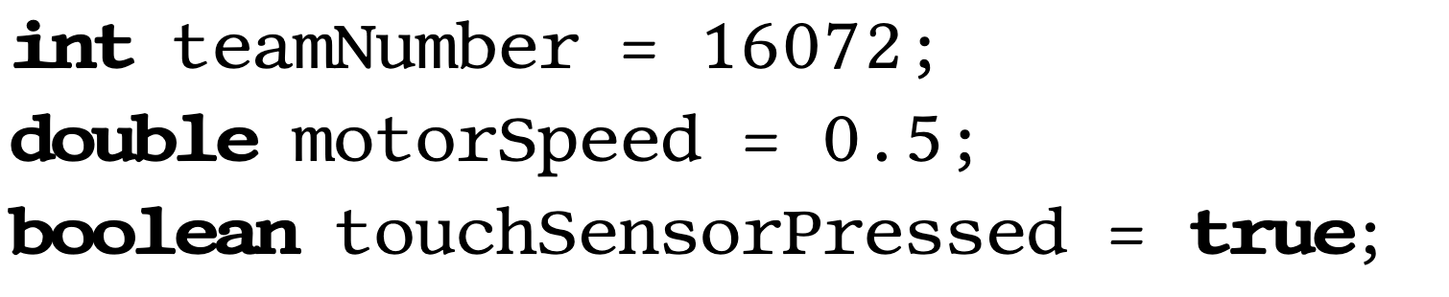
Variables Rules
* Denotes the ability to be assigned later. Unlike other values
Name
Value*
Type
Coding/Java Fundamentals

Slide 22
The String Class
String is really a class that we treat as a variable (Array of char’s).
By convention, class names start with a Capital letter and then every other word is also capitalized. (PascalCase)
Once defined, String’s cannot be changed, but they can be replaced.
Strings use “” while chars use ‘’
String myName = “Matthew Allen”;
Note that: String myName = ‘Matthew Allen’; -- Throws an error
Coding/Java Fundamentals

Slide 23
The String Class
Strings are objects so must be treated with strange rules. For example…
String A = "Hello";
String B = "Hello";
return (A == B);
Will return false because it will use the addresses of A and B. Where as…
String A = "Hello";
String B = "Hello";
return A.equals(B);
Returns true because .equals() is a custom method that will compare strings.
Coding/Java Fundamentals

Slide 24
The String Class
Notable String Methods include…
String A = “Abc ”;
A.trim(); “Abc”
A.length(); 6 (Includes whitespace, otherwise 3)
A.toLowerCase(); “abc”
A.toUpperCase(); “ABC”
A.charAt(0); ‘A’
A.substring(1, (Optional)→ 5); “bc. ”
A.equals(A); true
Coding/Java Fundamentals

Slide 25
Inline Math
You can (And will) do math in line!
Math Operator | Meaning
= | Assignment Operator. int A = 1;
==, >, >=, <, <= | Comparison Operator. A == B, A >= B, etc.
+ | Addition Operator. int A = 1 + 1;
- | Subtraction Operator AND negative operator. int A = 1 - 1; int B = -5;
* | Multiplication Operator. int A = 5 * 5; //25
/ | Division operator - be aware that if you are using integers only the whole part is kept. It is NOT rounded. int A = (5 / 2); //2
% | Modulo Operator - This gives the remainder. int A = 5 % 2; // 1
( ) | These are parenthesis and they allow you to specify the order of operations just like in regular math.
Coding/Java Fundamentals

Slide 26
Inline Math++
These are some more…
Math Operator | Example
++ | x++ means the same as x = x + 1
-- | x-- means the same as x = x - 1
+= | x += 2 means the same as x = x + 2
-= | x -= 2 means the same as x = x - 2
*= | x *= 2 means the same as x = x * 2
/= | x /= 2 means the same as x = x / 2
%= | x %= 2 means the same as x = x % 2
Coding/Java Fundamentals

Slide 27
Comments
You can (and should) add comments to the program which the computer ignores and are for human readers only. Comments should explain why and not what.
Type | Example(s)
Single Line | // This is a comment
Block comment | /* This is also a comment */ /* So is this */ /* * me * too!! */
Javadoc comment (For later) | /** * This is a javadoc comment */
Coding/Java Fundamentals

Slide 28
What did you learn in the last section?
Talk about it with a friend then everyone will tell me 1 (or more) things they learned or have a question about :)

Slide 29
Making Decisions
(Scary)
Break??

Slide 30
Comparison Operators
Operator | Meaning
== | is equal to
!= | is not equal to
< | is less than
> | is greater than
<= | is less than or equal to
>= | is greater than or equal to
A common mistake is trying to test for equality with the assignment operator = instead of the equality operator ==.
Making Decisions

Slide 31
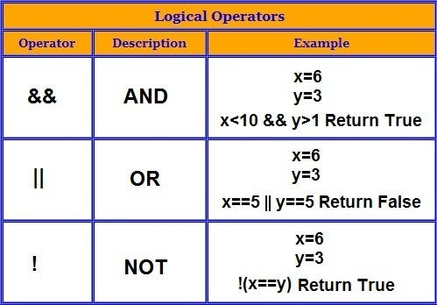
Logical operators (AND, OR, NOT)
Making Decisions

Slide 32
Logical operators (AND, OR, NOT) – Way to advanced but cool imo
Conditional Identity: P → q ≡ !P V Q
De Morgan's Laws: !(P ^ Q) ≡ !P V !Q OR !(P V Q) ≡ !P ^ !Q OR A ∩ B ≡ A U B OR
A U B = A ∩ B
Identity Laws: P ^ T ≡ P OR P V F ≡ P
Domination Laws: P V/U T = T OR P ^/∩ F = F
Idempotent Laws: P ^/∩ P ≡ P OR P V/U P ≡ P
Double Negation Law: !!P ≡ P
Commutative Laws: P ^/∩ Q ≡ Q ^/∩ P OR P v/U Q ≡ Q v/U P OR P ^/∩ Q ^/∩ R ≡ Q ^/∩ R ^ /∩ P ≡ R ^/∩ P ^/∩ Q
Associative Laws: (p ^/∩ q) ^/∩ r ≡ p ^/∩ (q ^/∩ r) OR (p v/U q) v/U ≡ p ≡ (q v/U r)
Distributive Laws: P ^/∩ (q V/U r) ≡ (p ^/∩ q) V/U (p ^/∩ r) OR P V/U (q ^/∩ r) ≡ (p v/U q) ^/∩ (p v/U r)
Complement / Negation Laws: P ^/∩ !p ≡ F OR P V/U !p ≡ T
Absorption Laws: P ^/∩ (p v/U q) ≡ p OR P v/U (p ^/∩ q) ≡ p
Lab 1: ¬p∧(p∨q) ≡ ¬p∧q
Biconditional Law: p ↔ q ≡ (p∧q)∨(¬p∧¬q)
De Morgan’s Laws for Quantified Statements:
!∀x: P(x ) ≡ Ǝx: !P(x) OR !Ǝx: P(x ) ≡ ∀x*: !P(x)
P → Q ≡ !Q → !P OR A B = A B OR A B = A B
Making Decisions

Slide 33
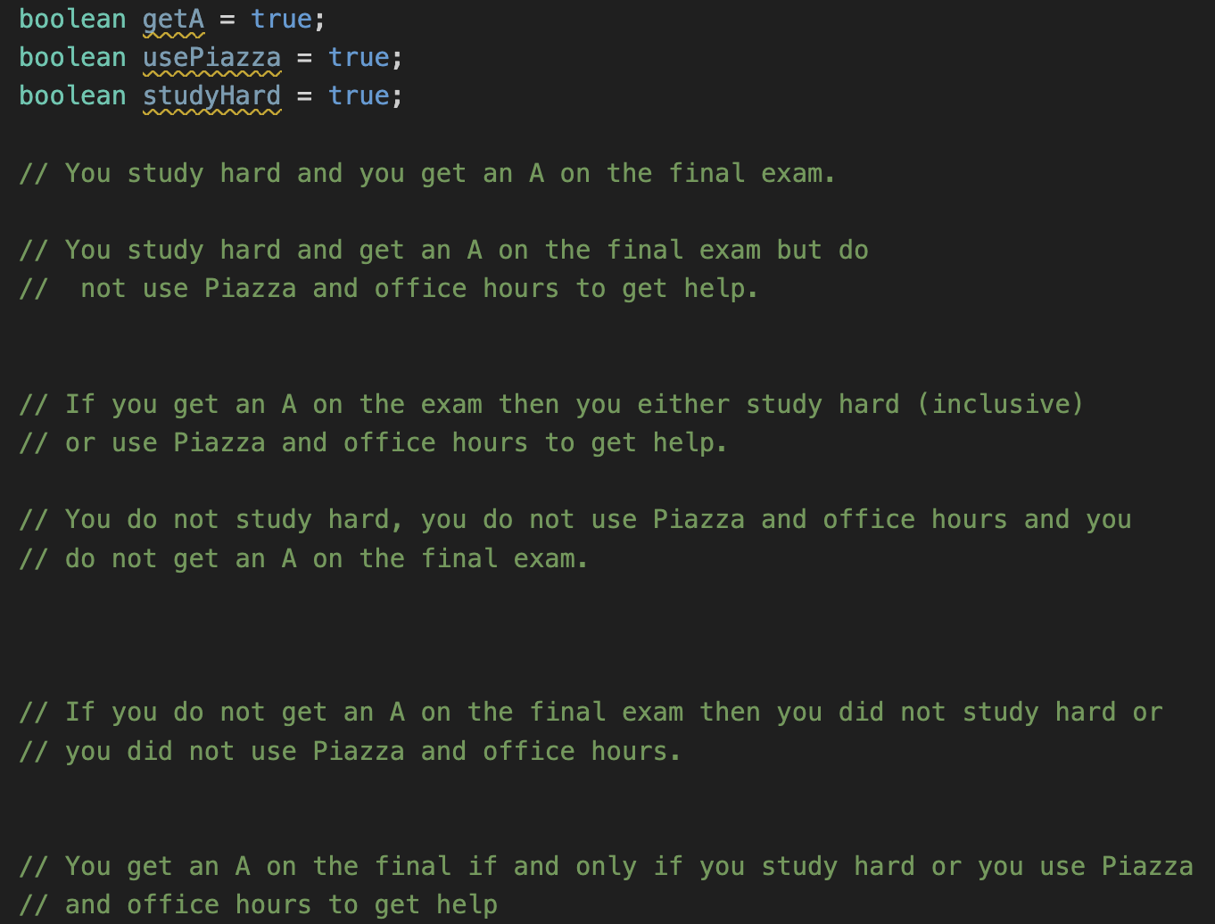
Convert to logic statements:
← These last two are a bit trickier
Making Decisions

Slide 34
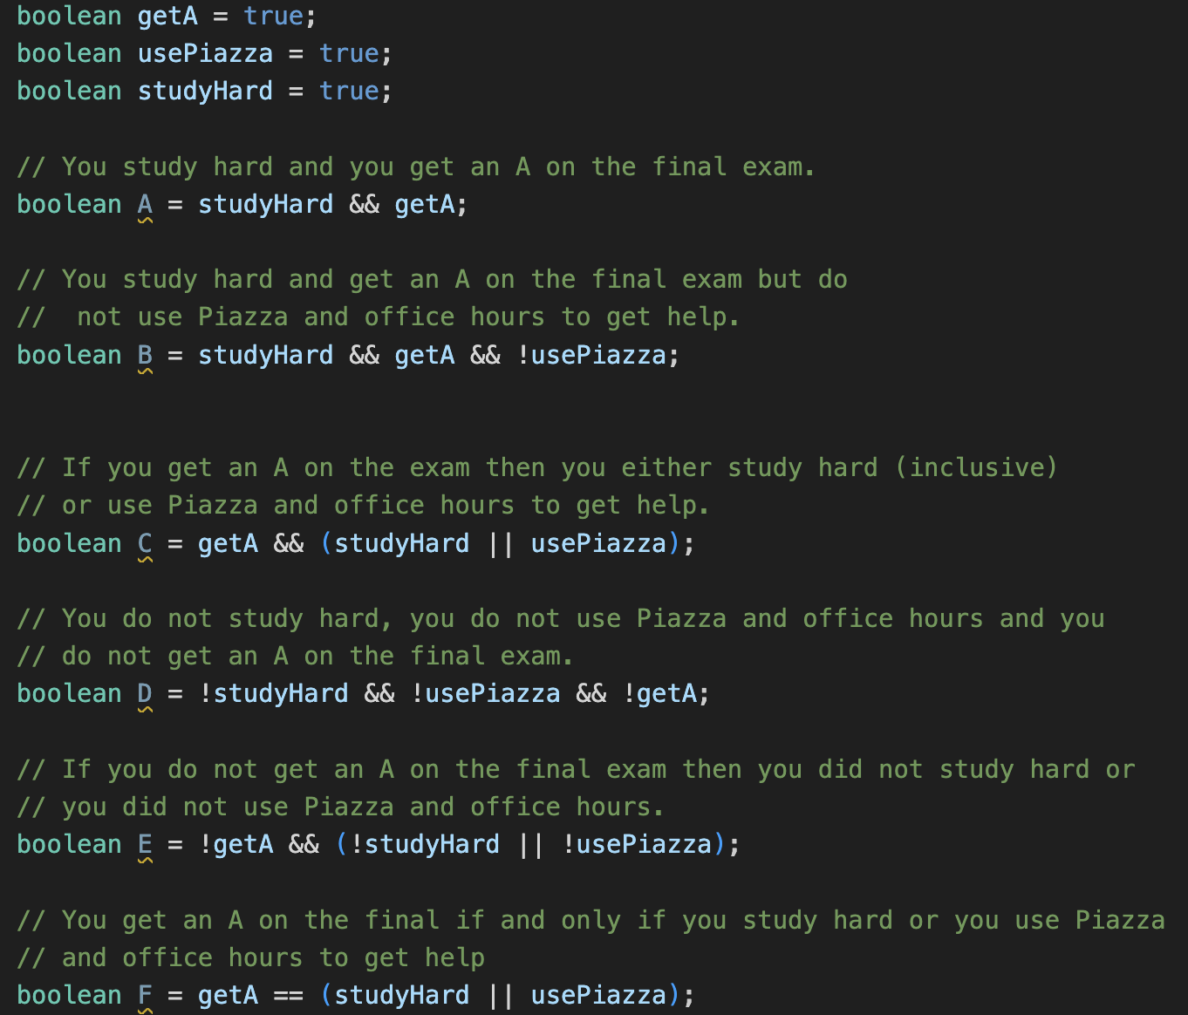
How many did you get??
← Did anyone get this one?
Making Decisions

Slide 35
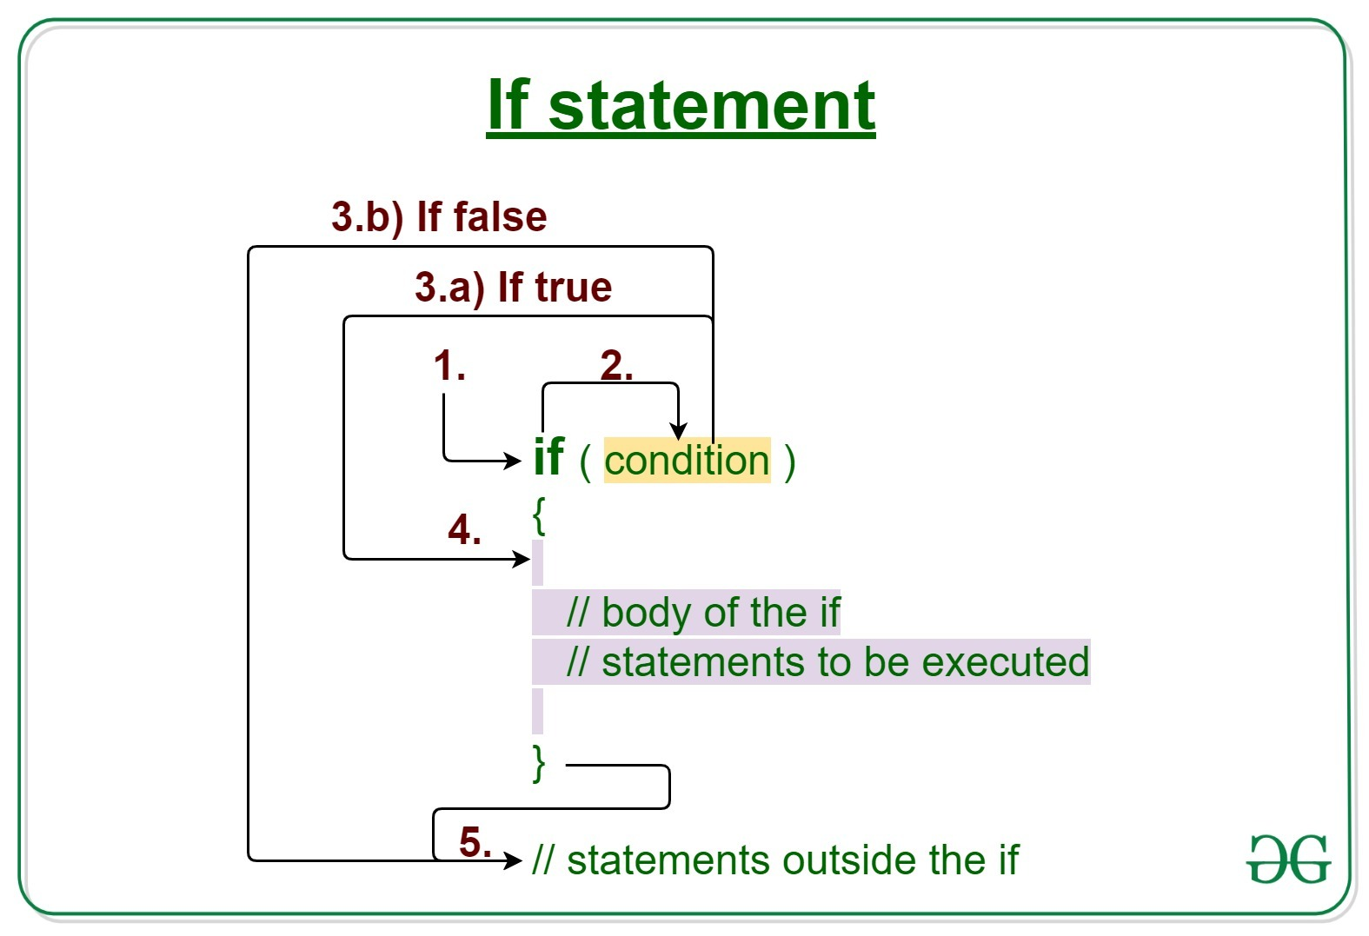
If/Else Statements
Making Decisions

Slide 36
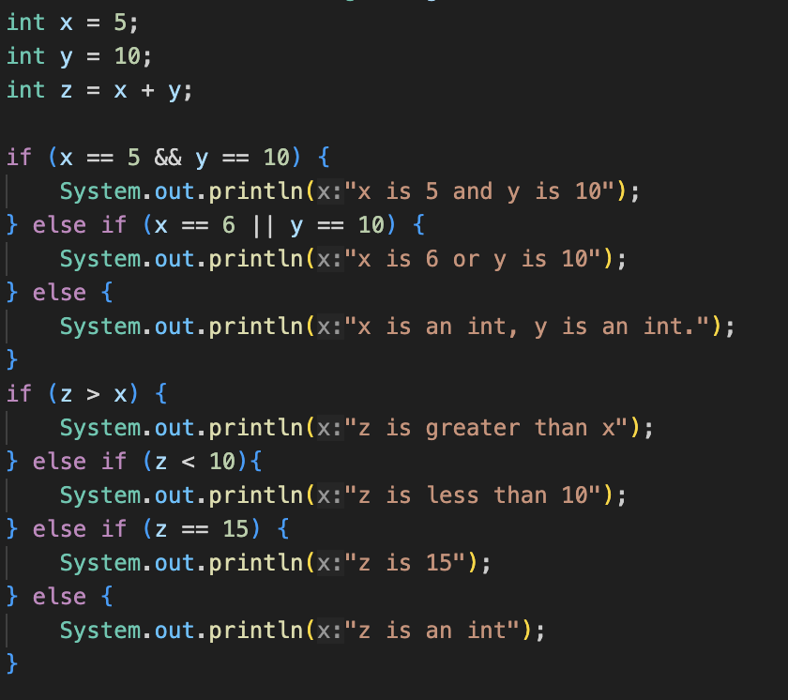
If/Else Statements – What Prints?
Making Decisions

Slide 37
If/Else Statements – What Prints?
x is 5 and y is 10
z is greater than x
Making Decisions

Slide 38
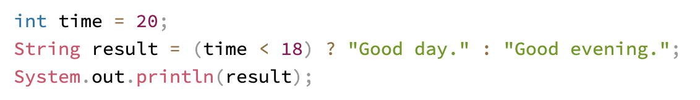
Inline if -- quirky
Making Decisions

Slide 39
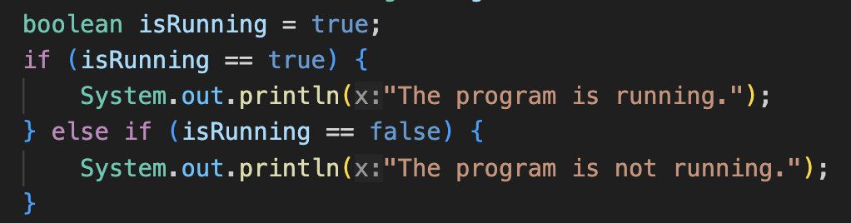
A Common Offense…
Making Decisions

Slide 40
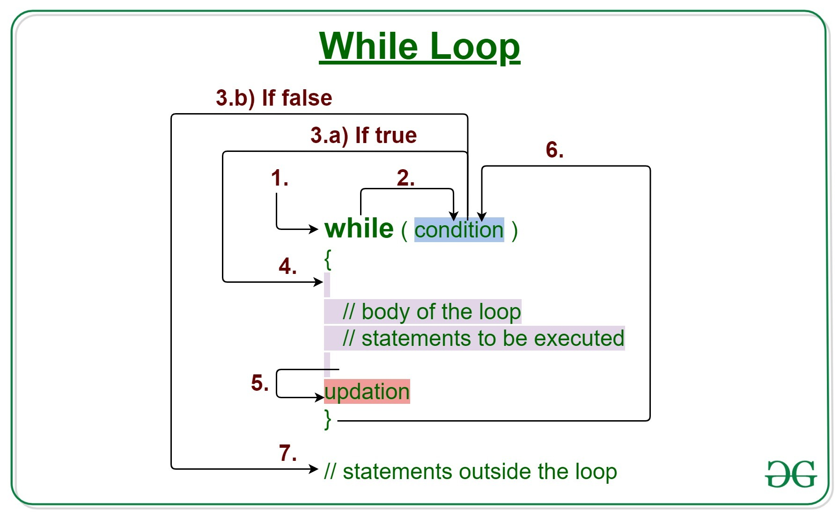
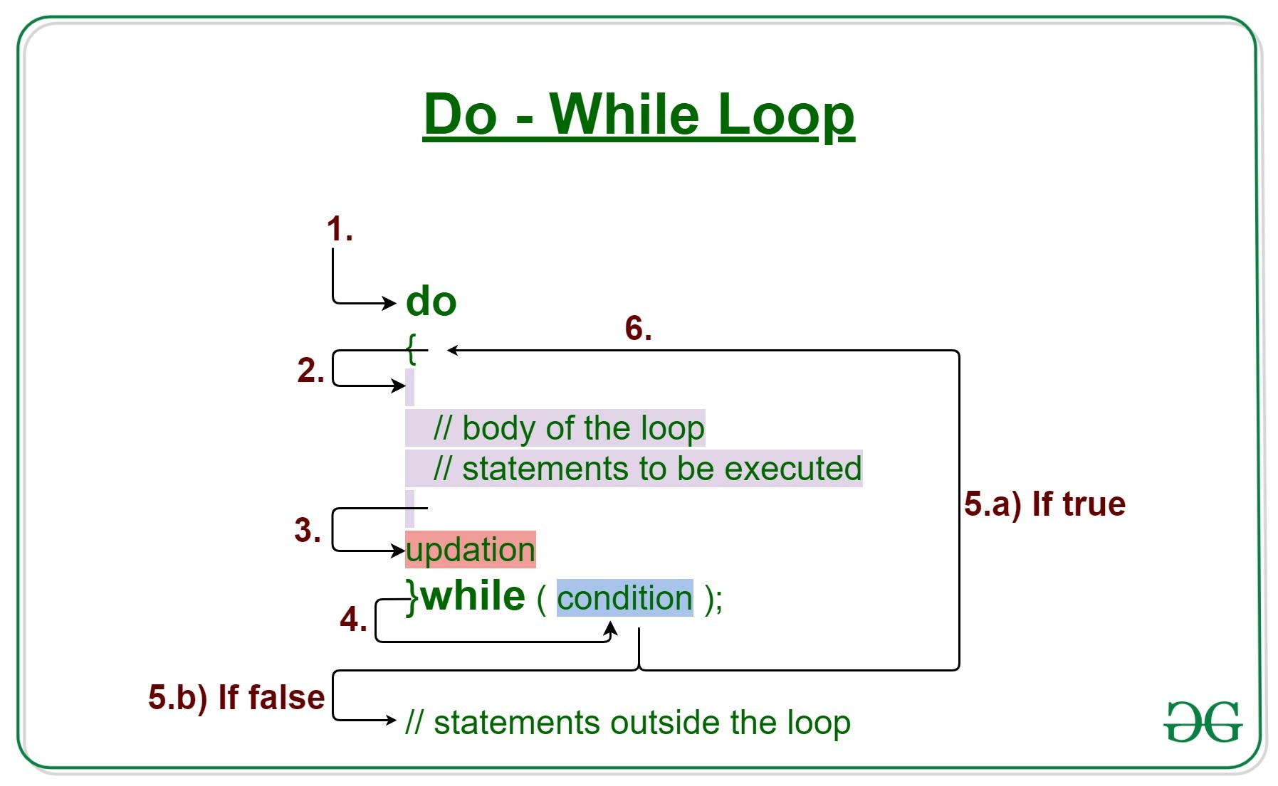
(Do) While Loops
Making Decisions

Slide 41
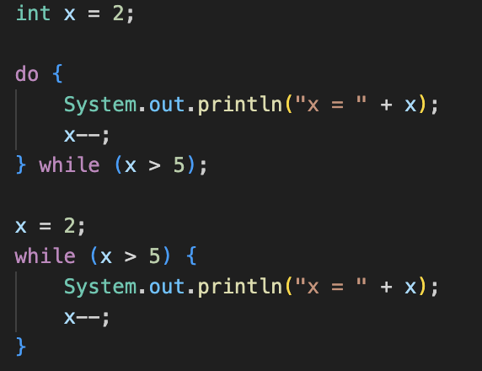
(Do) While Loops – What Prints?
Making Decisions

Slide 42
(Do) While Loops – What Prints?
X = 2
Making Decisions

Slide 43
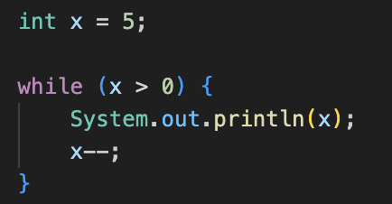
(Do) While Loops – What Prints?
Making Decisions

Slide 44
(Do) While Loops – What Prints?
5
4
3
2
1
Making Decisions

Slide 45
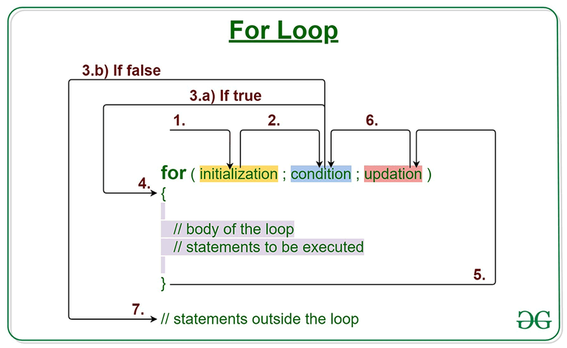
For Loops
Making Decisions

Slide 46
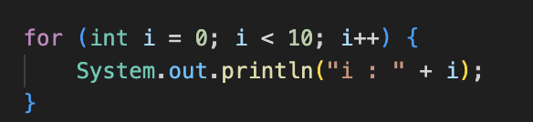
For Loops – What Prints?
Making Decisions

Slide 47
For Loops – What Prints?
i : 0
i : 1
i : 2
i : 3
i : 4
i : 5
i : 6
i : 7
i : 8
i : 9
Making Decisions

Slide 48
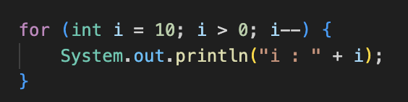
For Loops – What Prints Now?
Making Decisions

Slide 49
For Loops – What Prints Now?
i : 10
i : 9
i : 8
i : 7
i : 6
i : 5
i : 4
i : 3
i : 2
i : 1
Making Decisions

Slide 50
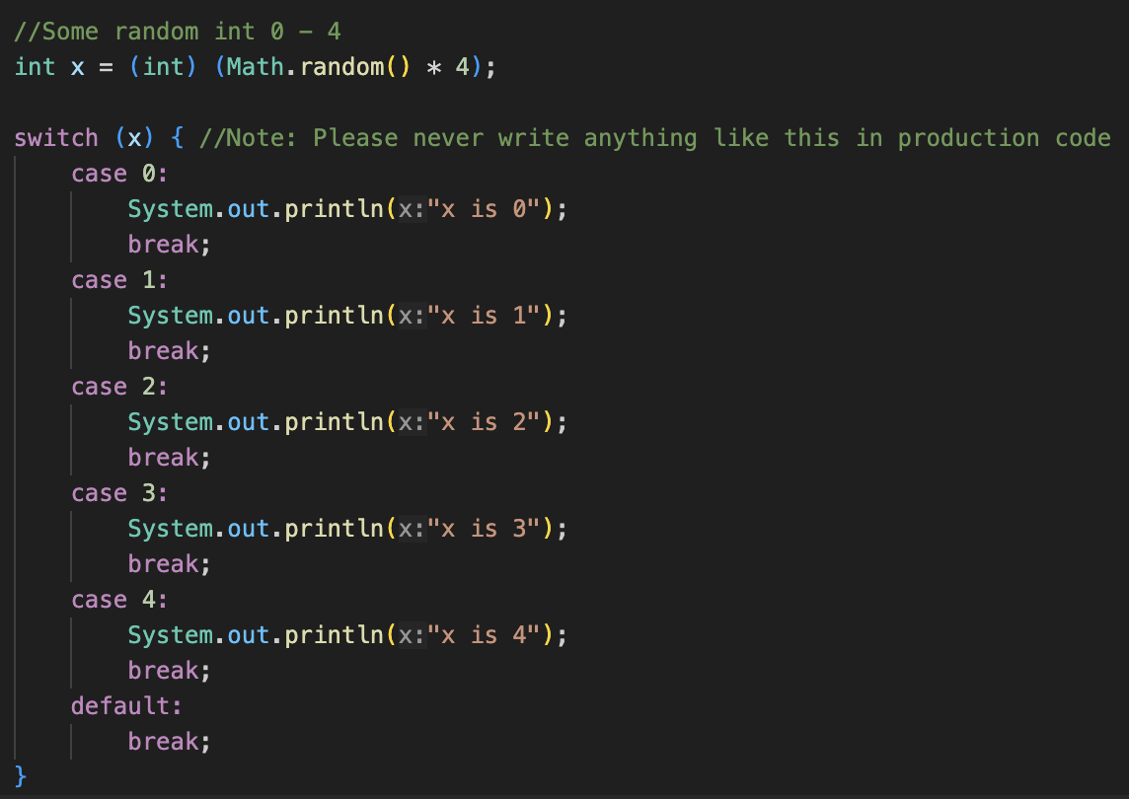
Switch(es)
Making Decisions

Slide 51
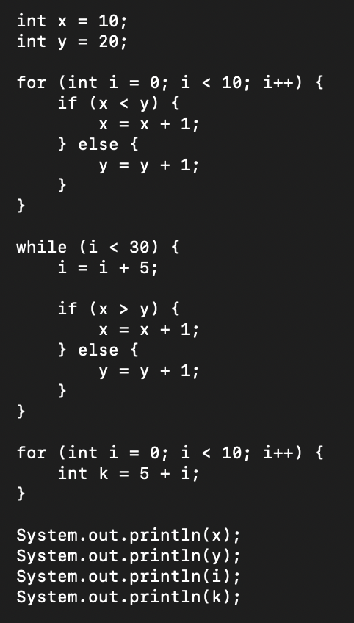
Variable Scope and Visibility
Find the errors ☺
Making Decisions

Slide 52
What did you learn in the last section?
Talk about it with a friend then everyone will tell me 1
(or more) things they learned or have a question about :)

Slide 53
First OpMode / Program
(About time)
Break??

Slide 54
What is an OpMode? (TeleOp vs Autonomous)
In FTC, An OpMode is a program for our robot. We can have multiple OpModes. They are all stored in the TeamCode package. They are all of type TeleOp or Autonomous (for now).
OpModes are required to have two methods: init() and loop()
There are three optional methods. These are less common but can be very useful: init_loop(), start(), and stop()
First OpMode / Program

Slide 55
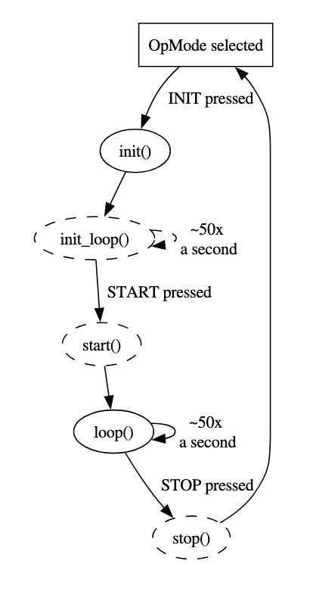
Understanding OpMode structure
Required Method | Function
init() | This is run once when the driver presses INIT.
loop() | This is run repeatedly (every 20 ms) after driver presses PLAY but before STOP.
Optional Method | Function
init_loop() | This is run repeatedly (every 20 ms) after driver presses INIT but before PLAY.
start() | This is run once when the driver presses PLAY.
stop() | This is run once when the driver presses STOP.
First OpMode / Program

Slide 56
Bonus: Quick Definitions (You don’t need to know these YET)
class | In Java all code is grouped together in classes. For now, just know that a class groups like code together and in Java, each class is in its own file that is named the same as the class with .java at the end For example: HelloWorld.java has the class “HelloWorld”
method | A method is a group of code within a class. Methods are the smallest group of code that can be executed. It is like a function (Python anyone??) in some languages or a MyBlock in EV3-G. For example: int add(int a, int b) {…} //Adds two ints
package | A directory in JAVA. It is where the code is located. Files in the same package have special privileges with each other. A package can have packages within it For example: “package org.firstinspires.ftc.teamcode;”
First OpMode / Program

Slide 57
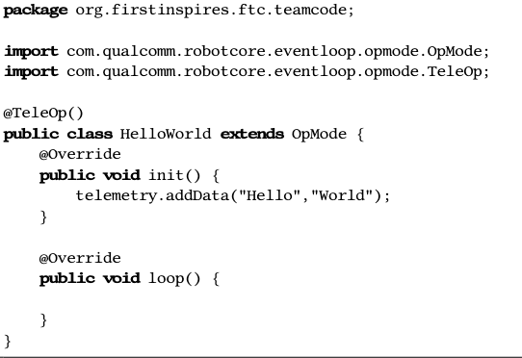
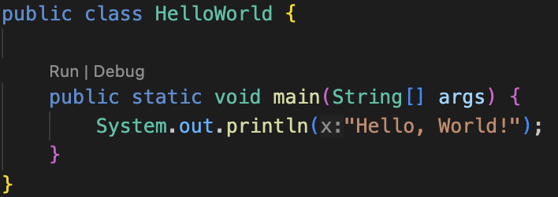
OpMode vs Regular Java
“OpMode/FTC Java”
“Regular Java”
First OpMode / Program

Slide 58
Creating a "Hello World" program
Android Studio (and other IDE’s) do this for you
Line 1 basically says where this file is located.
3 and 4 bring in code from the FTC SDK
(Software Development Kit) so we can use them
First OpMode / Program

Slide 59
Creating a "Hello World" program
This is CRITICAL. (Mainly for Robot Container) If you forget this line, it won’t show up on the DriverStation as an OpMode to select from.
Any line that starts with an @ is called an annotation.
You can choose from @Teleop() or @Autonomous().
You can optionally give it a name and a group, but if you leave those off then it will use your class name as the name.
Another annotation is @Disabled. If you have that, then your code will compile but it won’t be shown in the list of OpModes.
First OpMode / Program

Slide 60
Creating a "Hello World" program
public - means others can see it. Required for OpModes and most classes. We’ll learn about this later.
class - means we are defining a class. A class is defined from the opening curly brace “{“ to the closing curly brace
“}”
HelloWorld - this is the name of the class. It must be the same as the filename (except the filename has .java on it). By convention, it should be started with a capital letter and each new word is a capital letter (Pascal case).
extends OpMode - This means the class is a child of OpMode . A child gets all of the behavior of its parent and then can add (or replace) functionality. We will talk about this way later.
First OpMode / Program

Slide 61

Creating a "Hello World" program
@Override tells the compiler that we are meaning to override (replace) functionality in our parent class. We’ll discuss this later.
public means this method is callable from outside the class. We’ll discuss this later.
void means it doesn’t return anything.
init is the name of a method.
Inside of the parenthesis are any parameters passed in or none. (as in this case)
The method is defined from the opening curly brace “{“ to the closing curly brace “}”
First OpMode / Program

Slide 62
Creating a "Hello World" program
telemetry.addData(caption, value); This is very cool because it sends data to the driver station which lets us debug problems.
In this case we sent back a string, but you can (and will) also send back numbers or variables. You’ll notice that this ends in a semi-colon “;” All statements in JAVA either end with a semi-colon or have a set of curly braces attached.
First OpMode / Program

Slide 63
Creating a "Hello World" program
loop() looks much the same as our init() method, but there is no code in the loop() method, so the program won’t do anything here.
(We included it because it is required as a child of OpMode.)
First OpMode / Program

Slide 64

Now you! Creating a "Hello World" program
Install Android Studio with a copy of the FTC SDK.
(https://ftc-docs.firstinspires.org/en/latest/programming_resources/android_studio_java/install/install.html for help)
Create a java class file named “HelloWorld”
It should generate this:
Update this to “extends OpMode” it will have a warning at first. This is ok.
Can you do the rest alone?
First OpMode / Program

Slide 65
(Answer) Creating a "Hello World" program
First OpMode / Program

Slide 66
What did you learn in the last section?
Talk about it with a friend then everyone will tell me 1
(or more) things they learned or have a question about :)

